Slide 1

Psİkolojİ Alanında R Kullanımı
Why R? Turkey 2021
17/04/2021
Eren Halil ÖZBERK

Slide 2

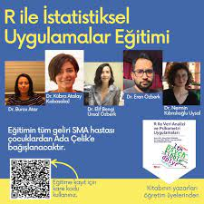


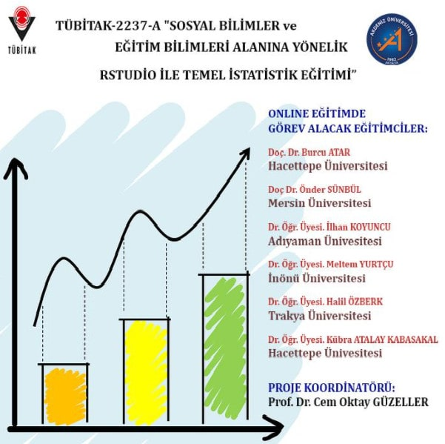


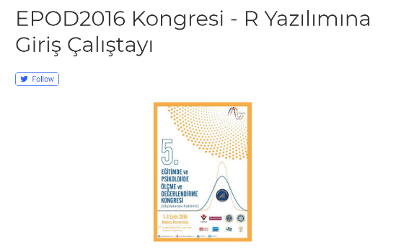


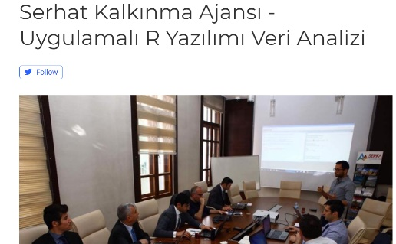
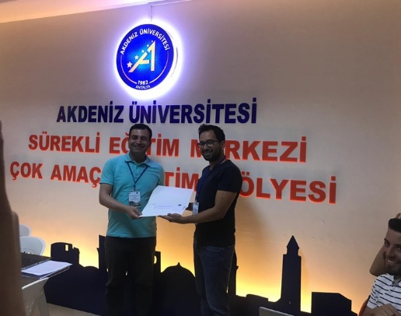
EĞİTİM
DENEYİM

Slide 3
It is rather surprising that systematic studies of human abilities were not undertaken until the second half of the last century… An accurate method was available for measuring the circumference of the earth 2,000 years before the first systematic measures of human ability were developed
Jum Nunnally, Psychometric Theory (1967)
Psychometry, it is hardly necessary to say, means the art of imposing measurement and number upon operations of the mind …”
Francis Galton, “Psychometric Experiments” (1879)

Slide 4
Psikometri Nedir?
Psikometri
Psikoloji
Eğitim
Sosyal Bilimler
NİCEL ÖLÇME UYGULAMALARI (quantitative measurement practices)

Slide 5
Psikometri Nedir?
Psikometri
Psikoloji
Eğitim
Sosyal Bilimler
NİCEL ÖLÇME UYGULAMALARI (quantitative measurement practices)

Slide 6
Psikometri Nedir?
Ölçme araçlarının geliştirilmesi
Gözlenen değişkenler (Zeka testi maddeleri) ile teorik yapıların (Zeka) ilişkilendirilmesi
Yeteneğin belirlenmesi

Slide 7
HANGİ YÖNTEMLER
Psikolojik Ölçekleme (Psychological Scaling)
Stevens (1951) Ölçme objelere ve olayları numaralandırma anlamına gelir.
Thurstone, bu numaralandırmayı standartlaştırmak için «scale» kavramı üzerinde duruyor.
Psikometrik Ölçme (Psychological measurement-test theory)
Gerçek Puanlar Teorisi (True Score Theory) – Güvenirlik Geçerlik
Madde Tepki Kuramı (Item Response Theory) –Rasch, Parameter based LM, GRM,PCM,NRM
DIF, DMF Değişen madde fonksiyonu
Faktör Analizi
Temel Bileşenler Analizi
Kovaryans Yapıları
Örtük Sınıf/Profil Analizleri
Yapısal Eşitlik Modeli
Psikolojik İstatistikler
Survey /Anket
Betimsel
Veri Görselleştirme
Jones, L. V., & Thissen, D. (2006). 1 A History and Overview of Psychometrics. Handbook of statistics, 26, 1-27

Slide 8



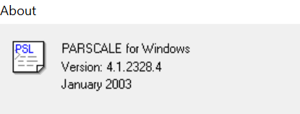
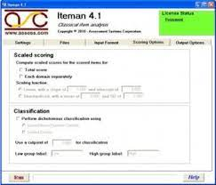
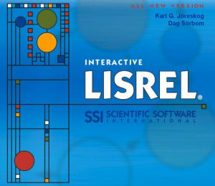

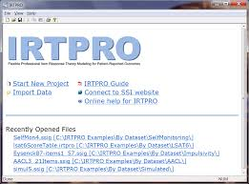




PEKİ R BU İŞİN NERESİNDE

Slide 9



PEKİ R BU İŞİN NERESİNDE

Slide 10
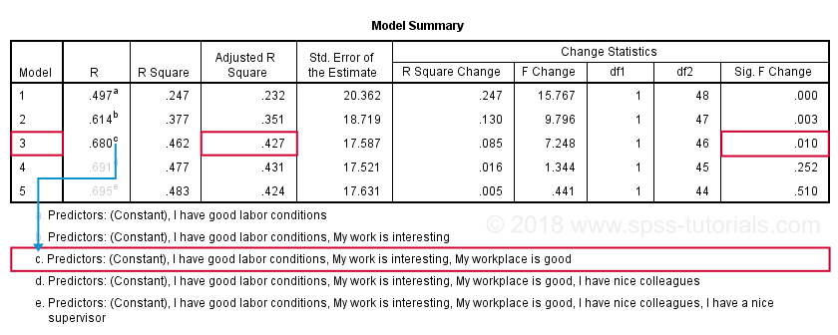
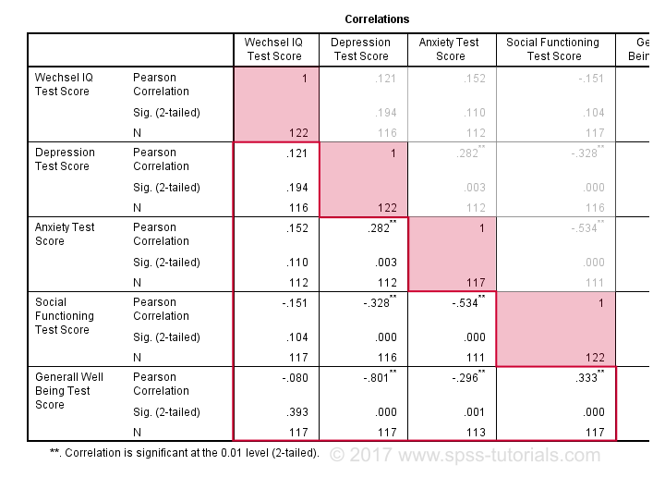
PEKİ R BU İŞİN NERESİNDE
Output kullanımı

Slide 11
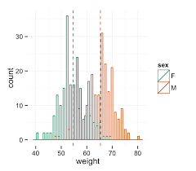
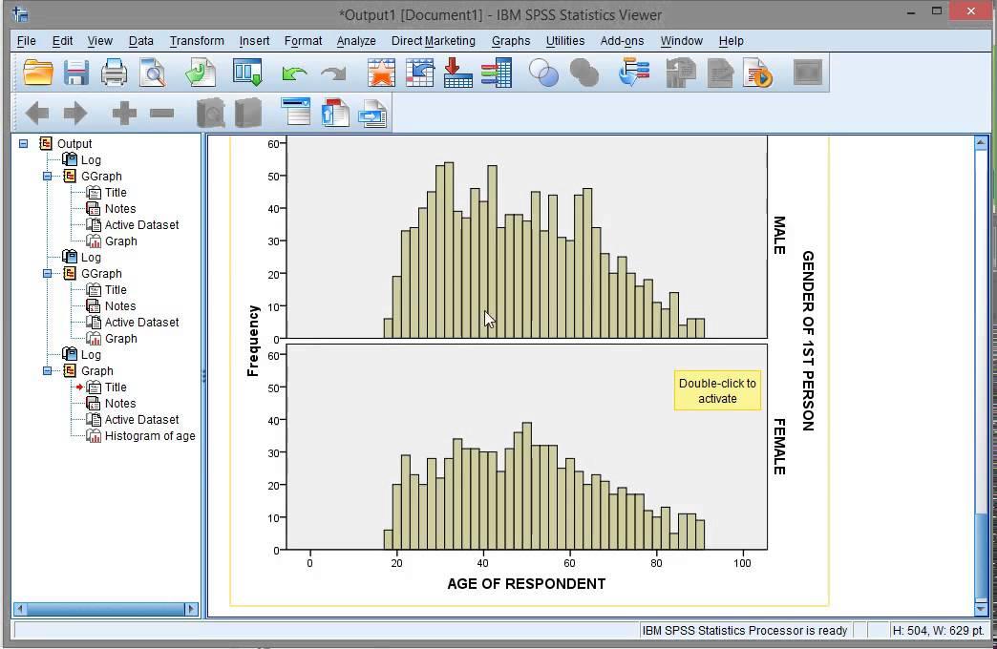
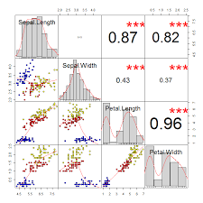
PEKİ R BU İŞİN NERESİNDE
Output kullanımı
Veri görselleştirme

Slide 12
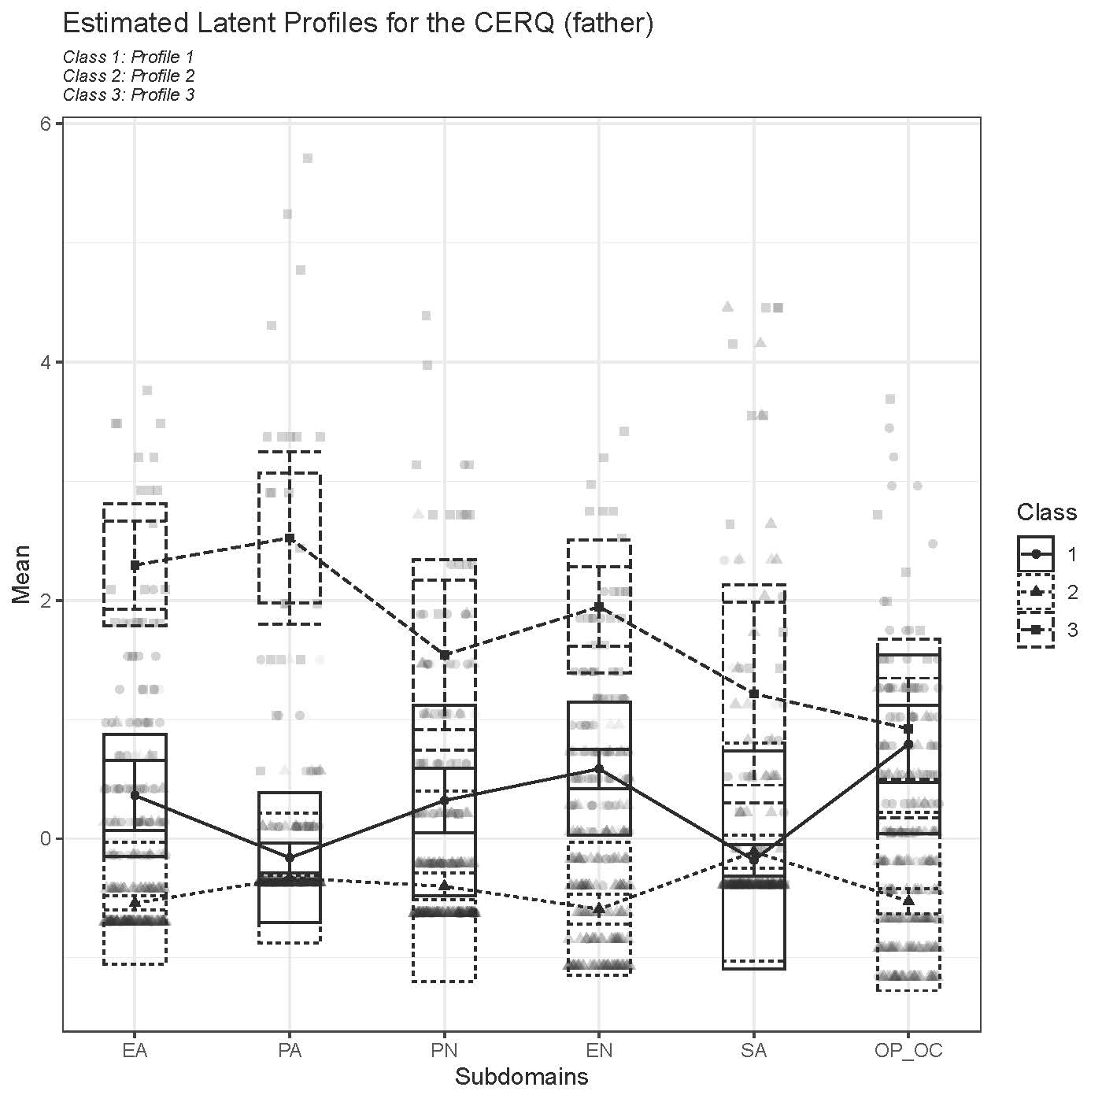
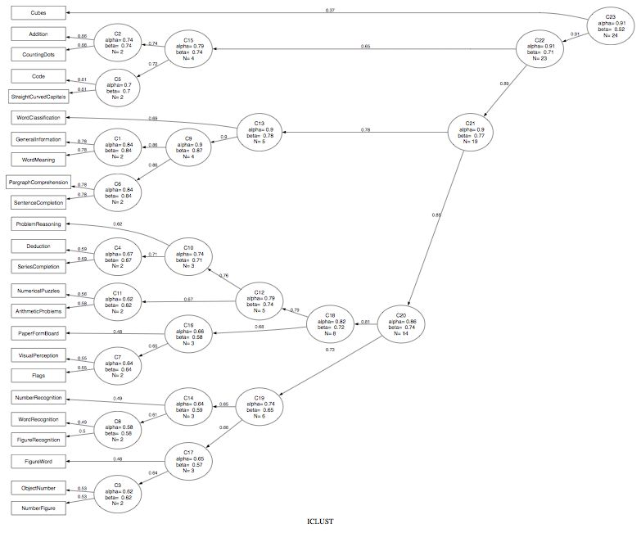
PEKİ R BU İŞİN NERESİNDE
Output kullanımı
Veri görselleştirme
Psikometrik analizler

Slide 13
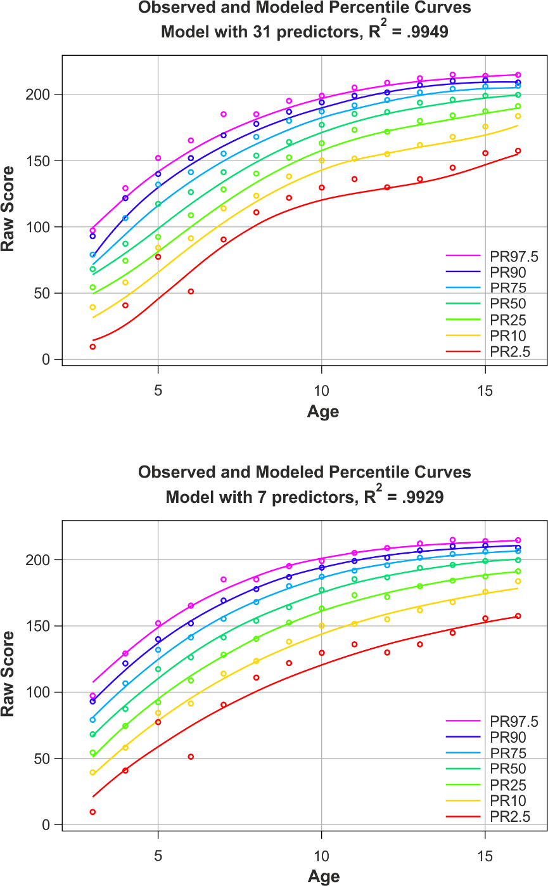
PEKİ R BU İŞİN NERESİNDE
Output kullanımı
Veri görselleştirme
Psikometrik analizler
Yaş Normları

Slide 14
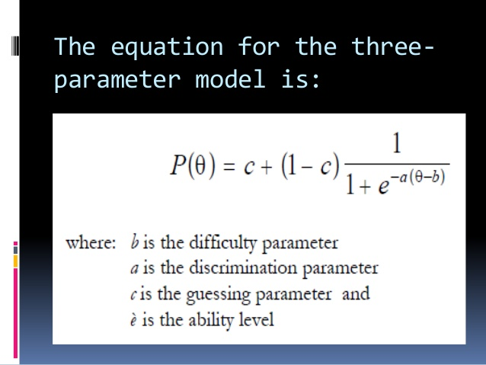
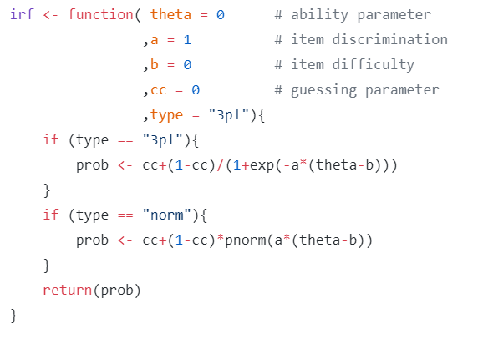
PEKİ R BU İŞİN NERESİNDE
Output kullanımı
Veri görselleştirme
Psikometrik analizler
Yaş Normları
Denklemlerin Kontrolü

Slide 15
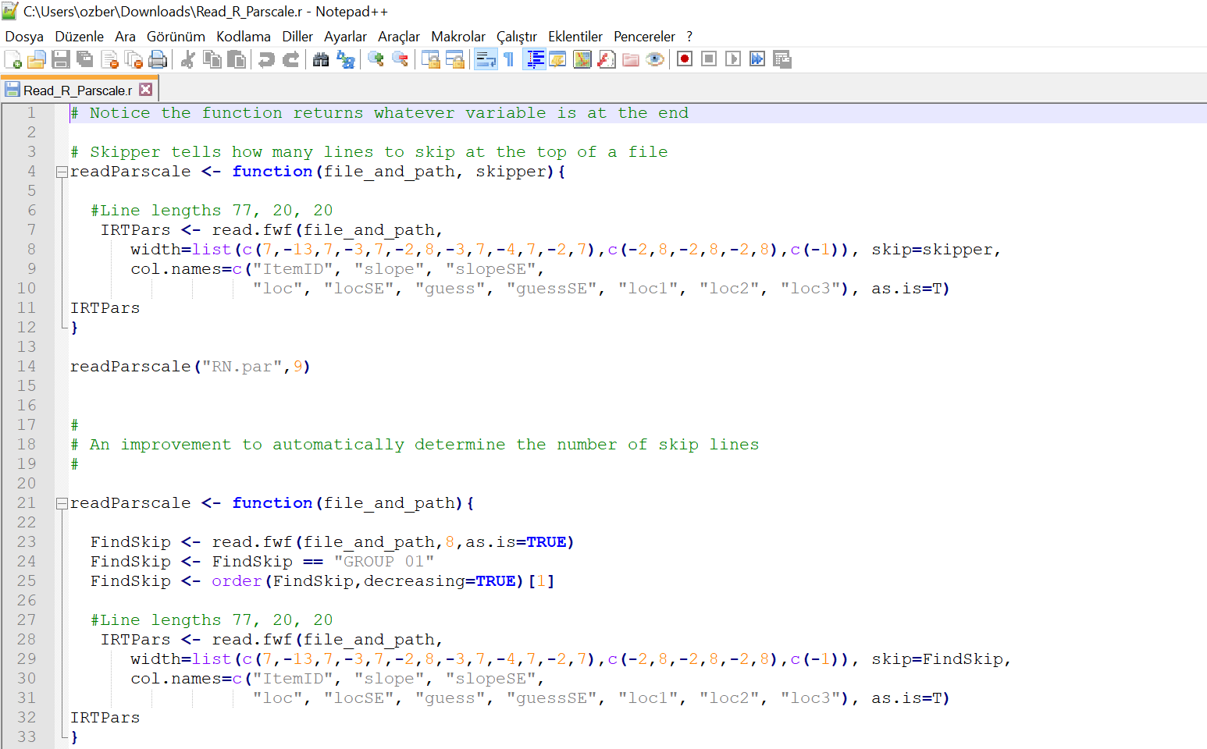

Slide 16
Psikolojinin çalışma alanları (PSİKOLOJİ ÖZELİNDE)
Örgütsel
Davranış Bilimleri
Nöropsikoloji
Klinik
Sosyal

Slide 17
ÇALIŞMALAR

Slide 18
ÇALIŞMALAR

Slide 19
ÇALIŞMALAR

Slide 20
ÇALIŞMALAR

Slide 21
ÇALIŞMALAR

Slide 22
ÇALIŞMALAR

Slide 23
ÇALIŞMALAR

Slide 24
PAKETLER
psych: Procedures for Psychological, Psychometric, and Personality Research
A general-purpose toolbox for personality, psychometric theory and experimental psychology. Functions are primarily for multivariate analysis and scale construction using factor analysis, principal component analysis, cluster analysis and reliability analysis, although others provide basic descriptive statistics. Item Response Theory is done using factor analysis of tetrachoric and polychoric correlations. Functions for analyzing data at multiple levels include within and between group statistics, including correlations and factor analysis. Functions for simulating and testing particular item and test structures are included. Several functions serve as a useful front end for structural equation modeling. Graphical displays of path diagrams, factor analysis and structural equation models are created using basic graphics.
NetworkToolbox: Methods and Measures for Brain, Cognitive, and Psychometric Network Analysis
Implements network analysis and graph theory measures used in neuroscience, cognitive science, and psychology. Aims to provide researchers with state-of-the-art methods and measures for estimating and analyzing brain, cognitive, and psychometric networks.

Slide 25
PAKETLER
psychometric: Applied Psychometric Theory
Contains functions useful for correlation theory, meta-analysis (validity-generalization), reliability, item analysis, inter-rater reliability, and classical utility
lavaan: Latent Variable Analysis
Fit a variety of latent variable models, including confirmatory factor analysis, structural equation modeling and latent growth curve models.
sem: Structural Equation Models
Functions for fitting general linear structural equation models (with observed and latent variables) using the RAM approach, and for fitting structural equations in observed-variable models by two-stage least squares.
cNORM: Continuous Norming
Conventional methods for producing standard scores in psychometrics or biometrics are often plagued with "jumps" or "gaps" (i.e., discontinuities) in norm tables and low confidence for assessing extreme scores.

Slide 26
UYGULAMA - Wechsler AdulT Intelligence Scale-RevIsed (WAIS-R)
McArdle and Prescott (1992, p.90) verisi
IN information
CO comprehension
SI similarities
VO vocabulary
PC picture completion
BD block design
PA picture arrangement
OA object assembly
Arithmetic, Memory Span for Digits, ve Digit Symbol Substitution dışarıda tutulmuştur.

Slide 27

UYGULAMA - Wechsler AdulT Intelligence Scale-RevIsed (WAIS-R)
McArdle and Prescott (1992, p.90) verisi
IN information
CO comprehension
SI similarities
VO vocabulary
PC picture completion
BD block design
PA picture arrangement
OA object assembly
Arithmetic, Memory Span for Digits, ve Digit Symbol Substitution dışarıda tutulmuştur.
Verbal

Slide 28

UYGULAMA - Wechsler AdulT Intelligence Scale-RevIsed (WAIS-R)
McArdle and Prescott (1992, p.90) verisi
IN information
CO comprehension
SI similarities
VO vocabulary
PC picture completion
BD block design
PA picture arrangement
OA object assembly
Arithmetic, Memory Span for Digits, ve Digit Symbol Substitution dışarıda tutulmuştur.
Verbal
Performance

Slide 29
UYGULAMA - Wechsler AdulT Intelligence Scale-RevIsed (WAIS-R)
WAIS Zeka Puanı Hesaplama Yöntemi,
Ham Puanları Hesapla
Z puanına dönüştür
IQ Puanı
(N=100, sd=15)
Alt Boyut IQ Puan Topla
Z puanına dönüştür
IQ Composite

Slide 30
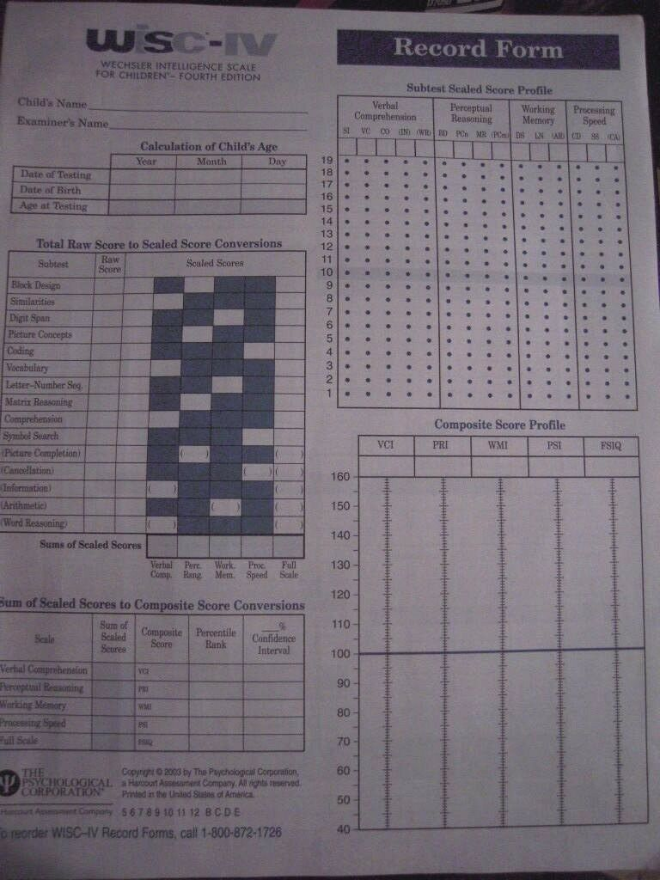

Slide 31
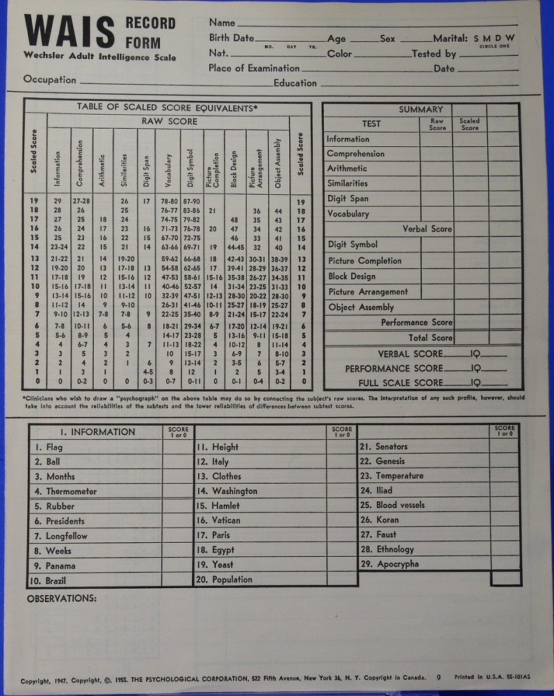

Slide 32
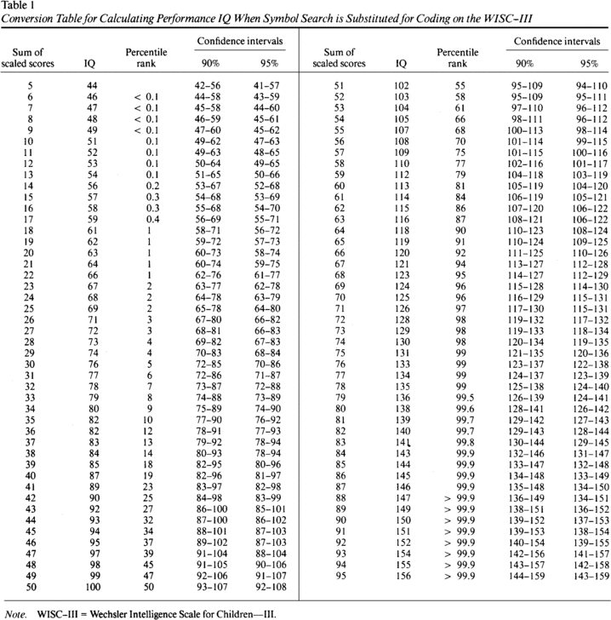

Slide 33
KAYNAKÇA
Jones, L. V., & Thissen, D. (2006). 1 A History and Overview of Psychometrics. Handbook of statistics, 26, 1-27.
McArdle, J. J., & Prescott, C. A. (1992). Age-based construct validation using structural equation modeling. Experimental Aging Research, 18, 87-115.
Nie, N. H., Bent, D. H., & Hull, C. H. (1975). SPSS: Statistical package for the social sciences (Vol. 227). New York: McGraw-Hill.
Rosenberg, J. M., Beymer, P. N., Anderson, D. J., Van Lissa, C. J., & Schmidt, J. A. (2019). tidyLPA: An R package to easily carry out latent profile analysis (LPA) using open-source or commercial software. Journal of Open Source Software, 3(30), 978.
Revelle, W., & Revelle, M. W. (2015). Package ‘psych’. The comprehensive R archive network, 337, 338.
Stout, W. (2002). Psychometrics: From practice to theory and back. Psychometrika, 67(4), 485-518.

Slide 34
TEŞEKKÜRLER

